Slide 1

Freelance platform using web scraping
An online site where the finest freelancers are placed in juxtaposition
-Shivam verma(S188003)
-Anushka gulave(s188026)
-Shivam mahale(s188034)

Slide 2

Contents
Introduction
Objective
Target audience
Technical Stuff
Future Scope
Conclusion
References

Slide 3

introduction
Freelancing is basically a different way to work. Rather than being employed by a company in one specific job, freelancers are self-employed and find work via a variety of sources. Clients hire a freelancer to complete a task, project, or service for them.
Freelance income varies depending on the skills offered, experience, and the targeting market.
Hence, we decided to create a Metasearch platform that’ll facilitate various organisations to get best freelancers at appropriate price using web scrapping.

Slide 4

objective
To create a Metasearch platform that’ll facilitate various organizations to get best freelancers at appropriate price using web scrapping.
The purpose of this website is to reduce the growth of direct traffic on some of the most famous websites. We are going to create a website where we are going to collect data from various freelancing websites and display it on a single interface to gain easy access to the data.
To create a user friendly interface for the users so it will be easy for them to find project according to their requirements.

Slide 5

Target audience / Stakeholders
Freelancers
Public / Private Organisations
Students
Customers

Slide 6
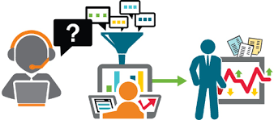
Data Collection Process
Data can be collected through :
From various websites such as freelancer.com, Upwork.com, etc.
Private individuals can also upload their requirements, skills, area of interest, experience, pricing, etc.

Slide 7



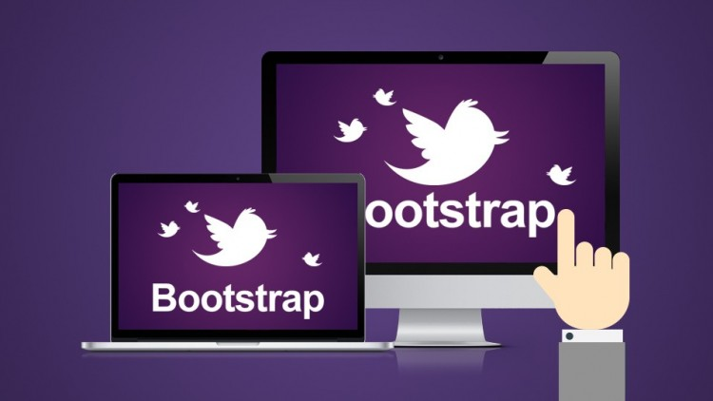
Technical stuff
Most website make use of both server side and client side. Front end scripting is good for anything that requires user interaction. Back-end scripting is good for anything that requires dynamic data to be loaded.
Server Side:
php is used as a sever side language.
Database used is MongoDB
Client Side:
Frontend language: HTML 5
Bootstap

Slide 8
conclusion
So all the projects will be under same website so it will be easy for the users to search for the projects. There will be various filters like project names,fields,price,etc.
No partiality will be there between new users and old users all the users will be treated same means no will be highlighted on top and everyone will get there own choice to choose their project according their skills.

Slide 9
Future scope
We will work more on user interface according to user feedbacks about the website and will apply more filters needed for the users.The communication between the user and the contractors will be improved by adding the features like quick chat,voice chat,etc. in future.

Slide 10
references
Scrapy platform
https://www.thebalancesmb.com/what-is-freelancing-1794415

Slide 11
THANK YOU!

